Slide 1
Applying NLP to extract entities from queries to answer relevant questions and surface search results from an IMDB movie dataset CS410 Final Project Usage Tutorial
Team-MK
Captain: Michael Haines (mhaines2)
Kevin Eveker (keveker2)

Slide 2
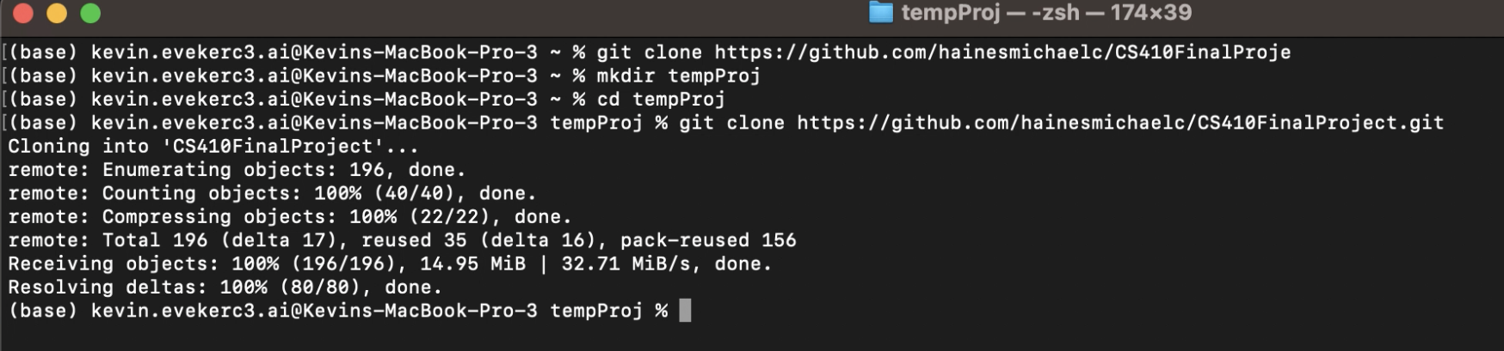
Usage Guide: Solution Setup (1 of 5)
We have a video that walks through these steps that can be found in our repo in the docs folder called: TeamMK_environment_setup_demo_720p.mov. It can also be found on github at this link.
Start by opening a terminal, creating a directory to work in, and cloning our repo:
git clone https://github.com/hainesmichaelc/CS410FinalProject.git

Slide 3
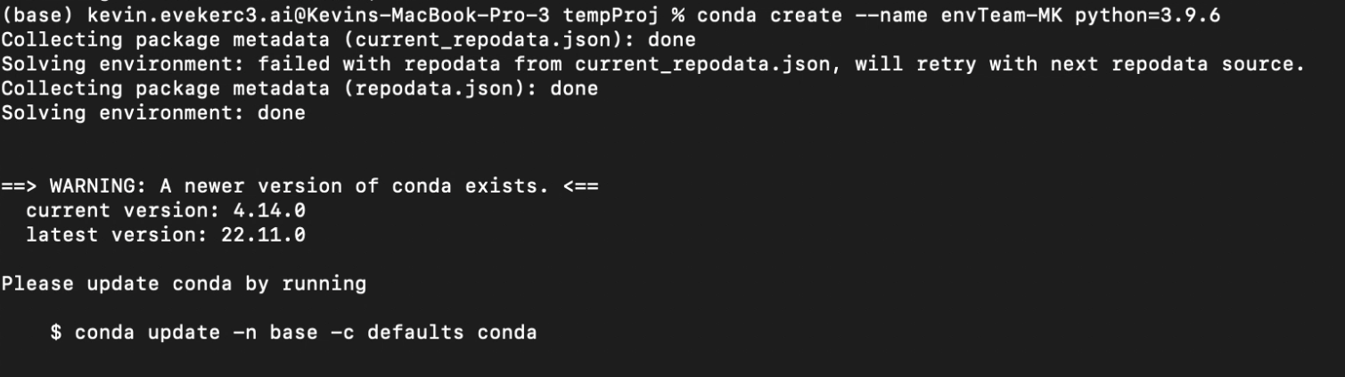
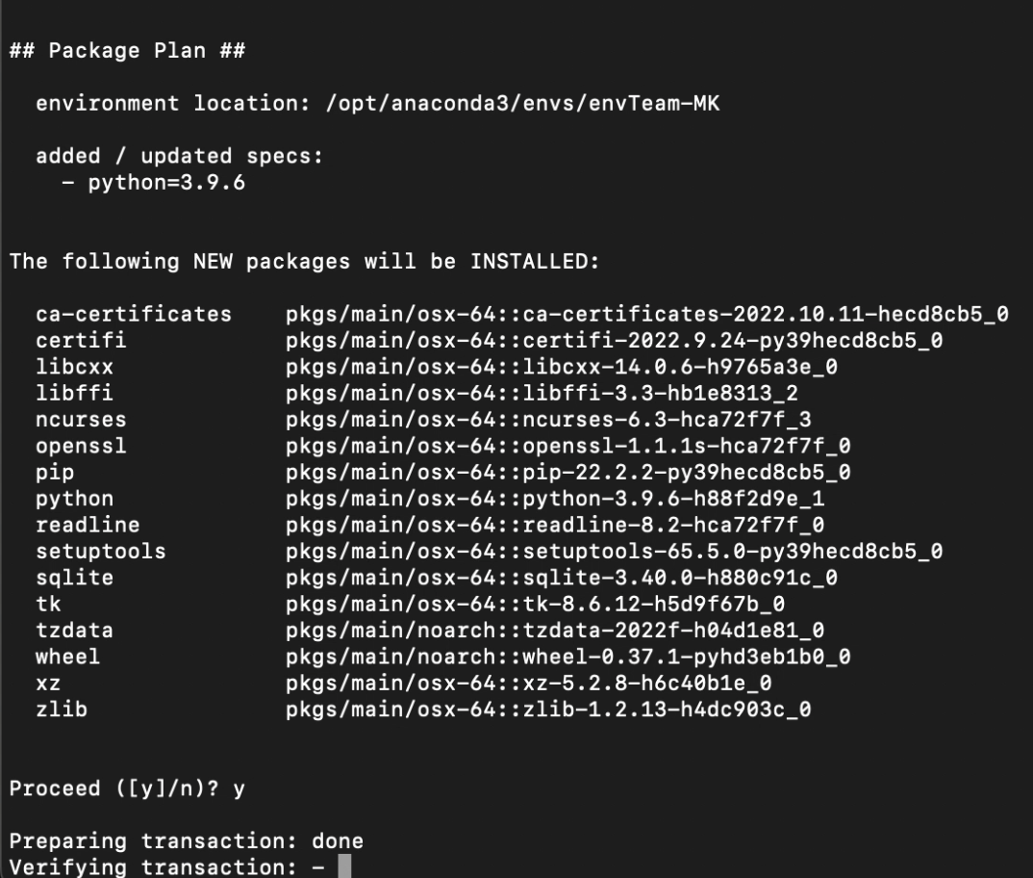
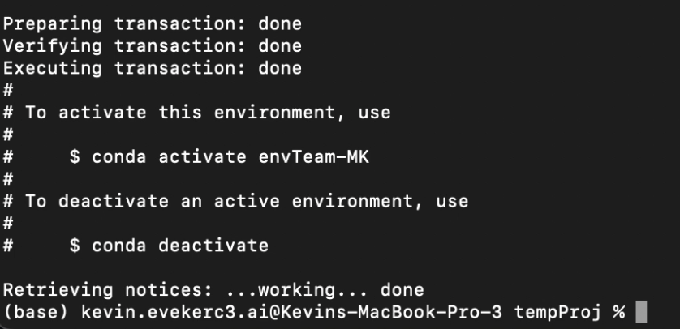
Usage Guide: Solution Setup (2 of 5)
Next step is to create a conda environment that has the right version of python:
conda create --name envTeam-MK python=3.9.6

Slide 4
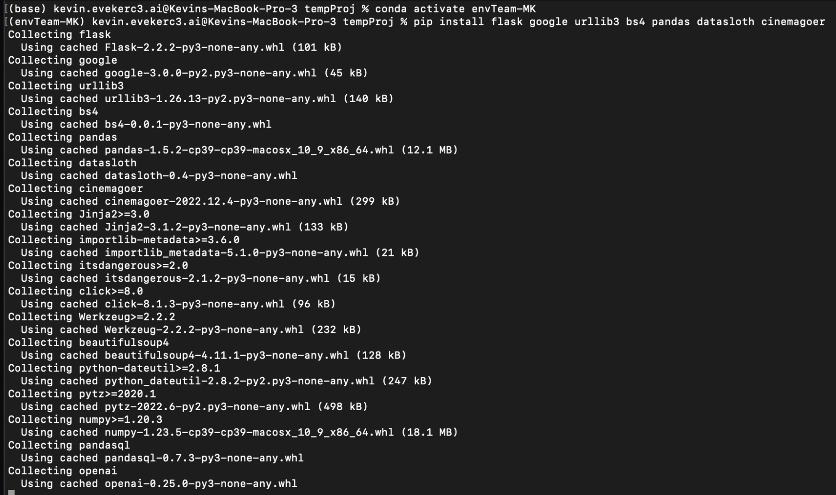
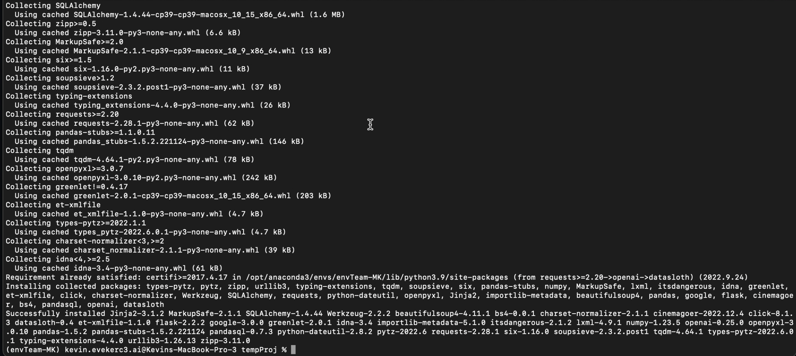
Usage Guide: Solution Setup (3 of 5)
Then activate the conda environment and install dependencies:
conda activate envTeam-MK
pip install flask google urllib3 bs4 pandas datasloth

Slide 5
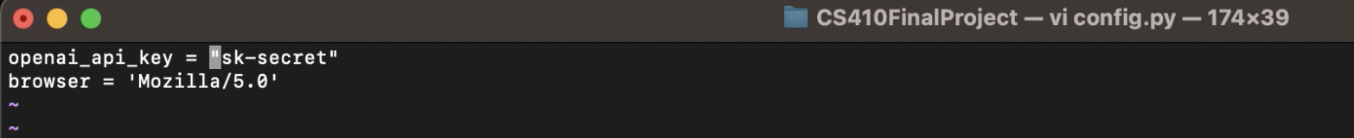
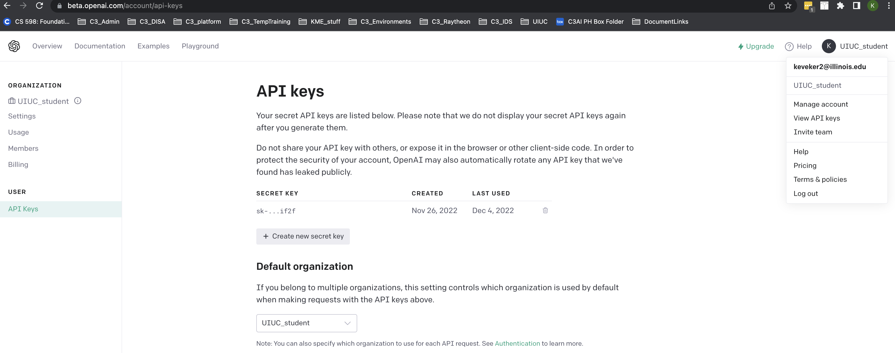
Usage Guide: Solution Setup (4 of 5)
Add your OpenAI API key to config.py:
vi config.py
Replace sk-secret with the API key you get from https://openai.com/api/

Slide 6
Usage Guide: Solution Setup (5 of 5)
Initialize your database:
cd scripts
python ./init_db.py
this step can take 30secs to 1 minute to complete, please stand by

Slide 7
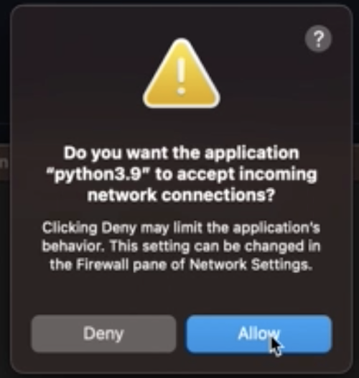
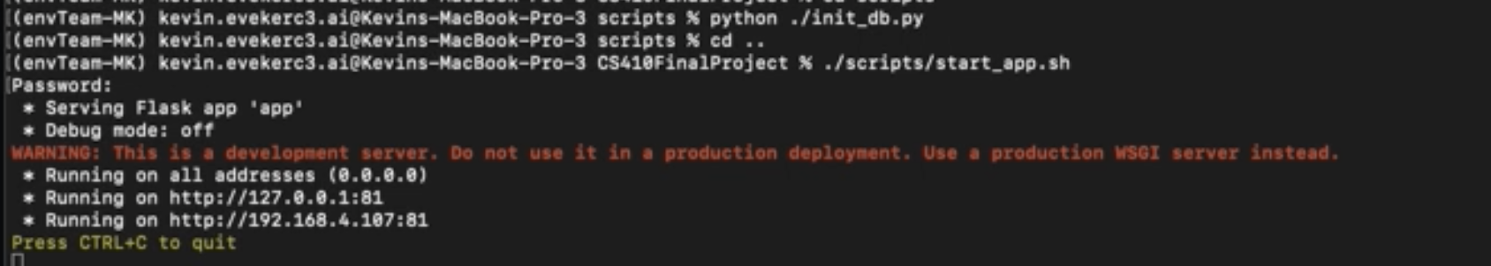
Usage Guide: Solution Usage (1 of 4)
We have a video that walks through these steps that can be found in our repo in the docs folder called: TeamMK_software_usage_demo_720p.mov. It can also be found on github at this link.
Move up to the main directory and run the start_app script
cd ..
./scripts/start_app.sh
Click on allow so that web app will work correctly

Slide 8
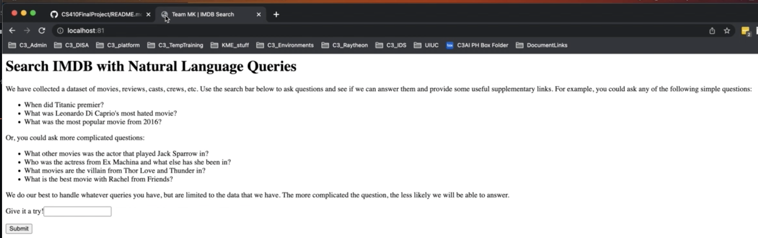
Usage Guide: Solution Usage (2 of 4)
Navigate in browser to:
localhost:81
This give you access to our software to run searches against out GPT-3 based engine, IMdB, and Google to compare results

Slide 9
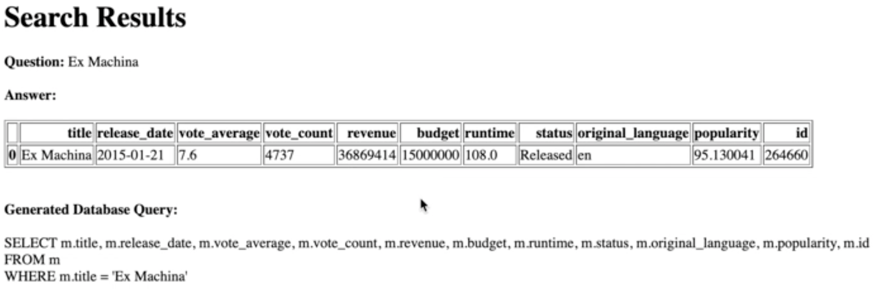
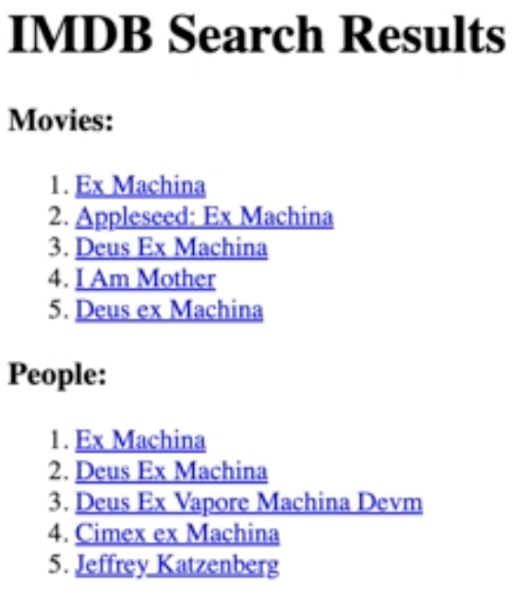
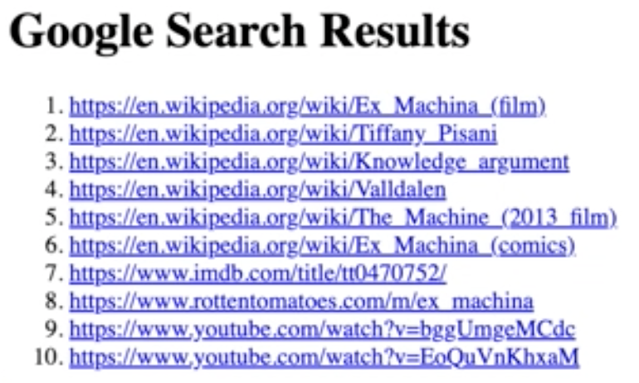
Usage Guide: Solution Usage (3 of 4)
A simple search for “Ex Machina” yields results from all 3 sources
Team-MK GPT-3 Based Result

Slide 10
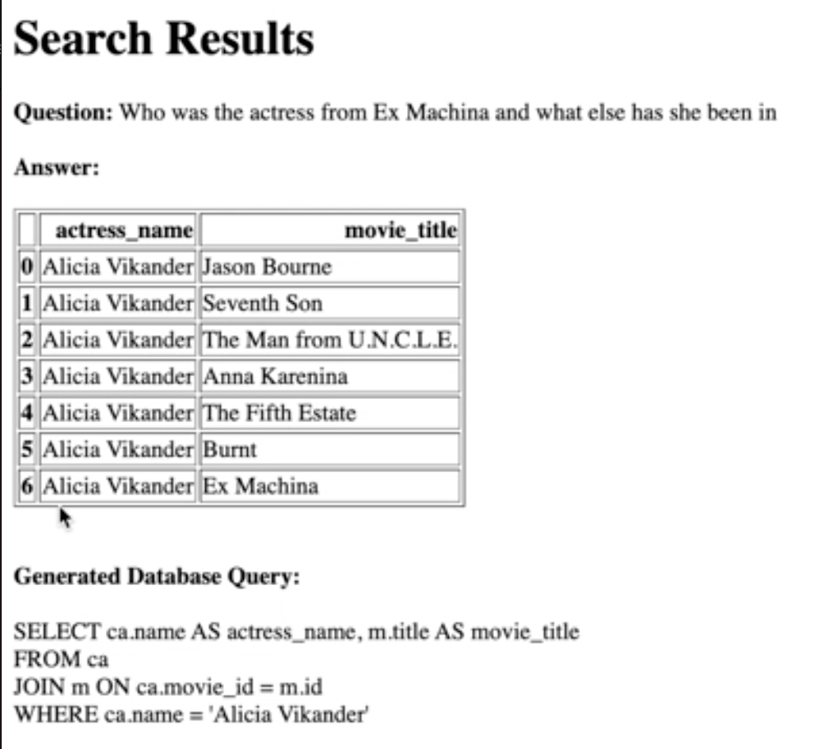
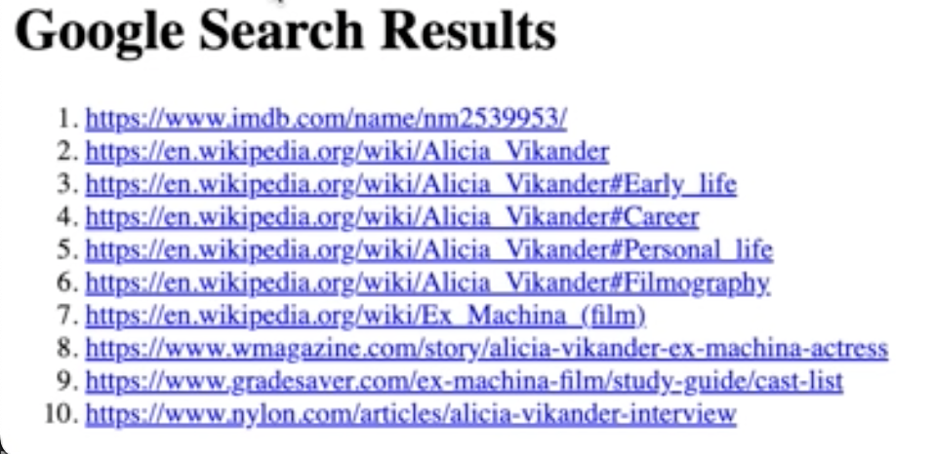
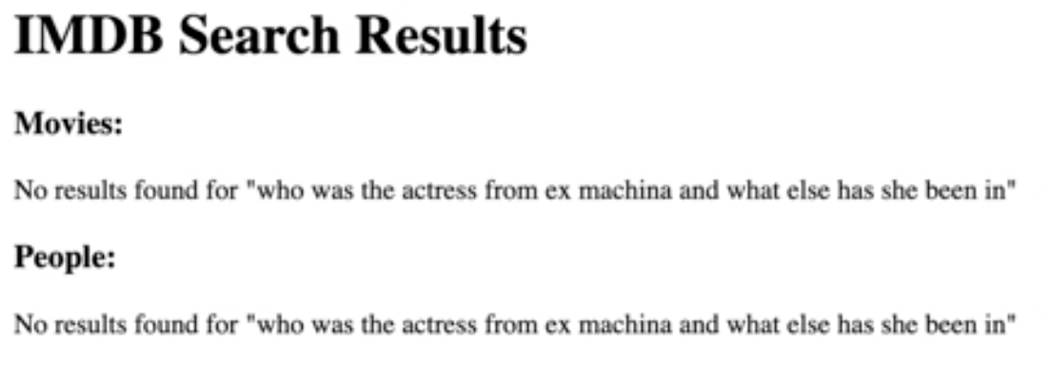
Usage Guide: Solution Usage (4 of 4)
A complex search for “Who was the actress from Ex Machina and what else has she been in” results in:
Team-MK GPT-3 Based Result

Slide 11
Please try your own queries to see how we compare to IMdB and Google

